Slide 1

Development of machine learning models to process Electronic Health Records – Explainable Models
Week 9 Meeting, 29/11/2021

Slide 2
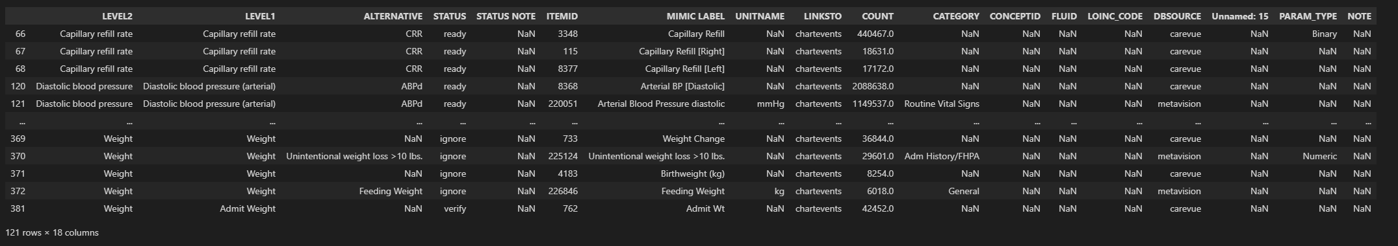
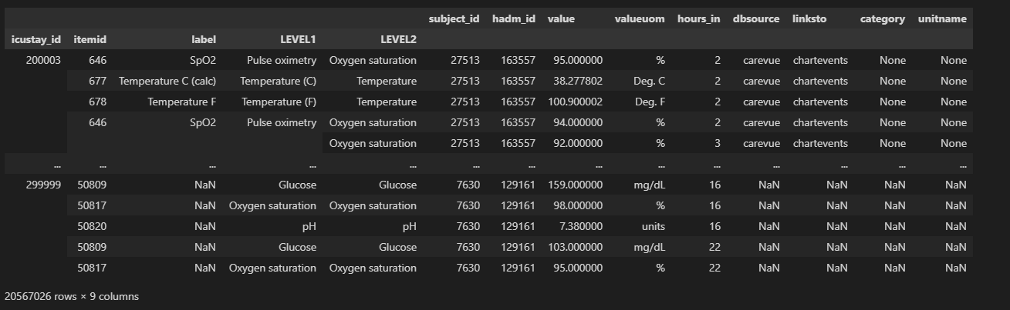
What does level 1 and level 2 mean?
var_map
Events_data

Slide 3
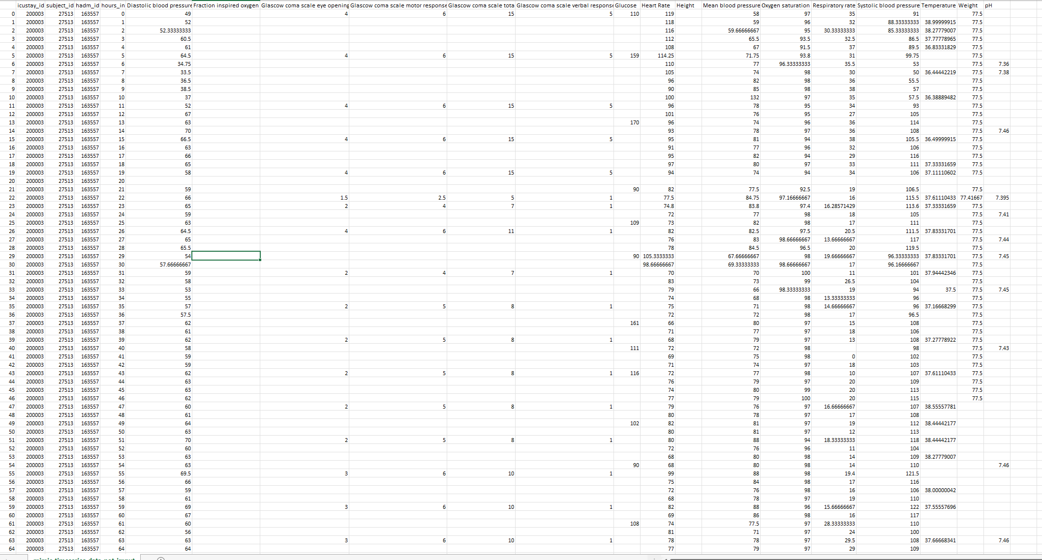
Missing data
There are a lot of missing data but it does make sense.

Slide 4
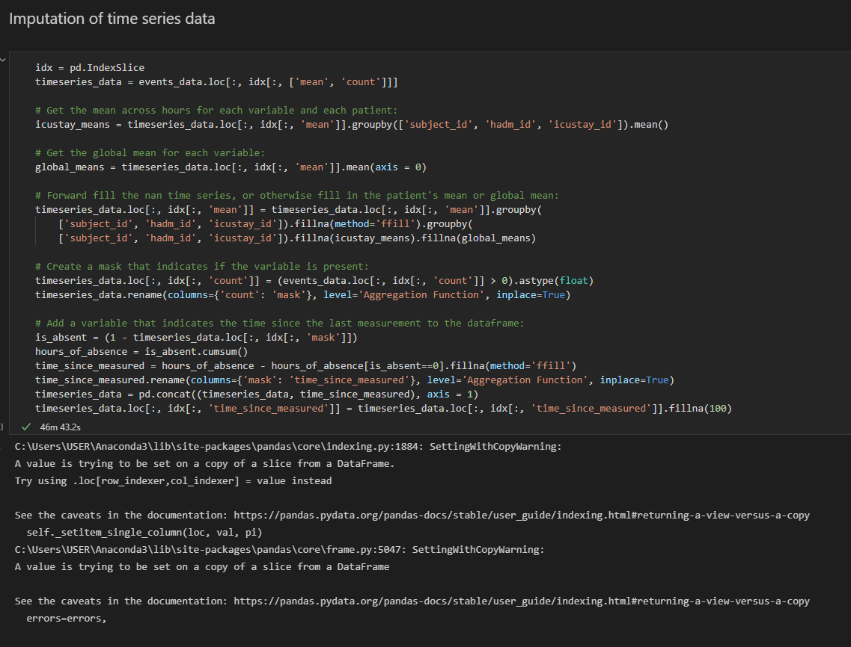
Pandas warning

Slide 5
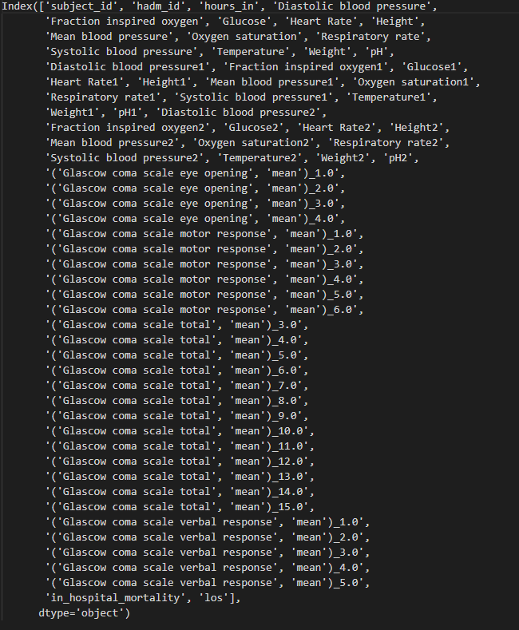
Weird columns

Slide 6
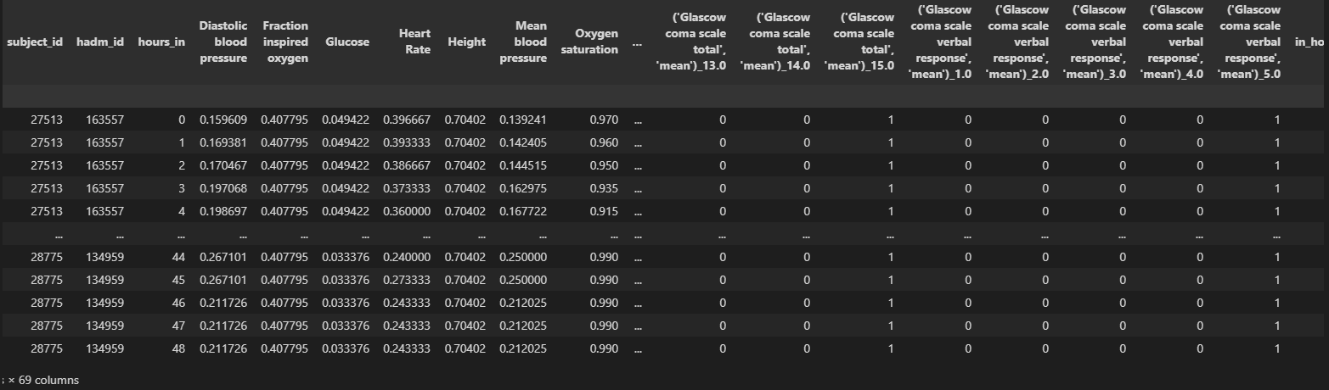

Slide 7
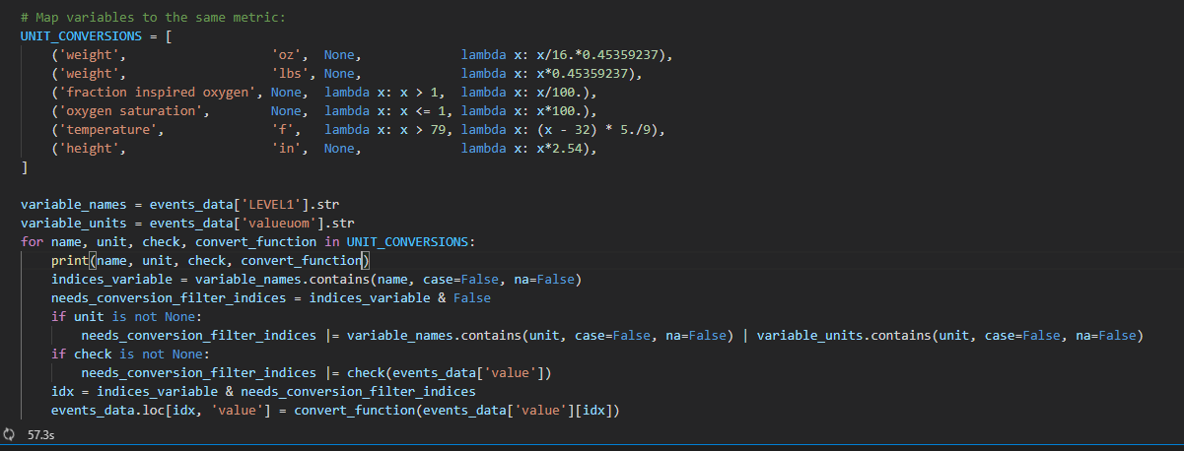
Height was always null

Slide 8
Findings
Data looks fine before the notebooks imputation strategies
Standardization of continuous data
One-hot encoding categorical variables

Slide 9
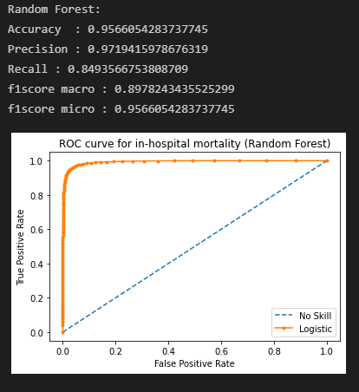
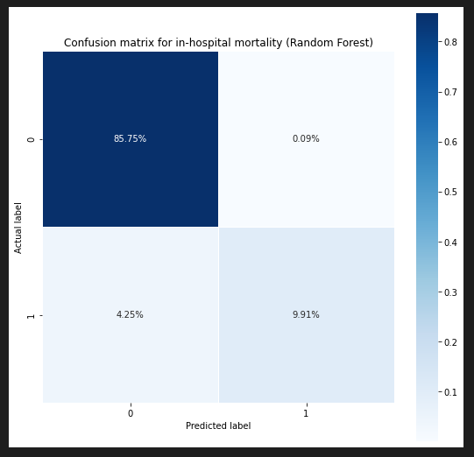
Did Some more machine learning!

Slide 10
Try different imputation strategies and see how it affects the accuracy
Nice story for the report

